Slide 1
Logic circuits – exercise 2.2
Cupeș Andrei – group 912

Slide 2
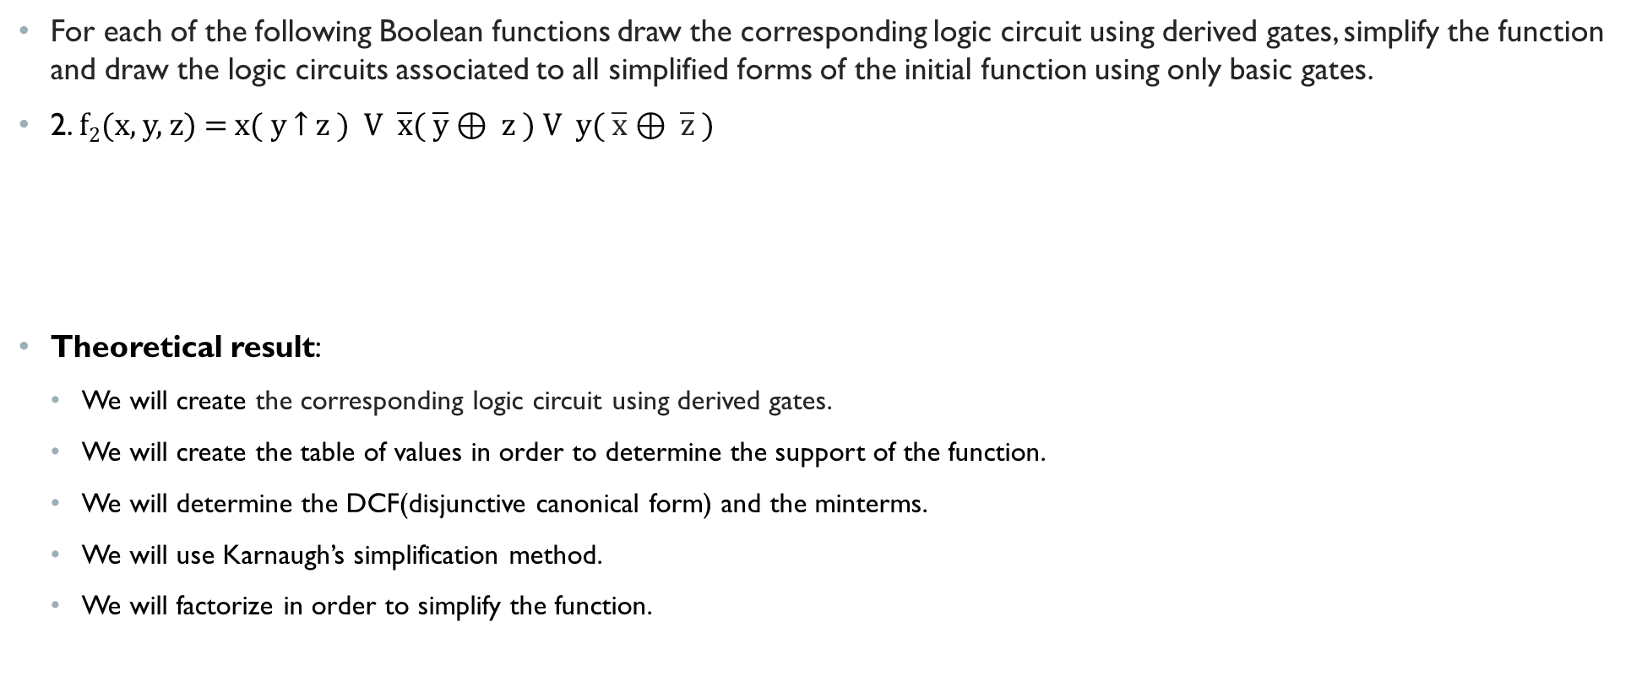
Exercise 2.2
For each of the following Boolean functions draw the corresponding logic circuit using derived gates, simplify the function and draw the logic circuits associated to all simplified forms of the initial function using only basic gates.
2. f₂(x, y, z) = x( y ­↑ z ) V $\overline{x}$( $\overline{y}$ ⊕ z ) V y( $\overline{x}$ ⊕ $\overline{z}$)
Theoretical result:
We will create the corresponding logic circuit using derived gates.
We will create the table of values in order to determine the support of the function.
We will determine the DCF(disjunctive canonical form) and the minterms.
We will use Karnaugh’s simplification method.
We will factorize in order to simplify the function.

Slide 3
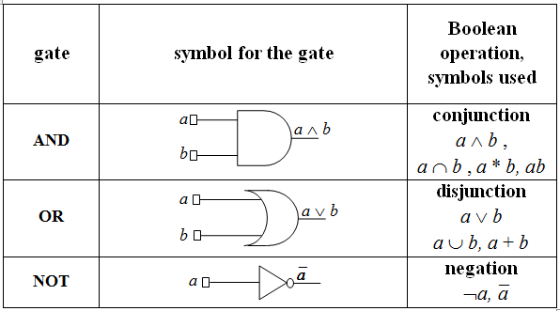
BASIC GATES

Slide 4
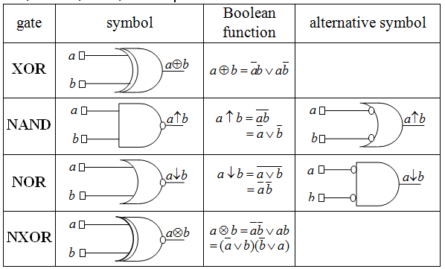
Derived gates

Slide 5

logic circuit using derived gates
f₂(x, y, z) = x( y ­↑ z ) V $\overline{x}$( $\overline{y}$ ⊕ z ) V y( $\overline{x}$ ⊕ $\overline{z}$)
x
y
z
y
NAND
(y↑­z)
AND
x(y↑­z)
z
x
y
⊕z
y
XOR
( )
⊕z
y
AND
x
OR
f₂ (x,y,z)
x
x
⊕
z
x
XOR
AND
⊕
z
( )
y
x
z
y

Slide 6
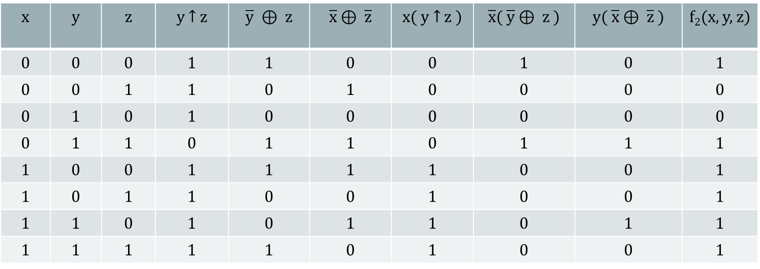

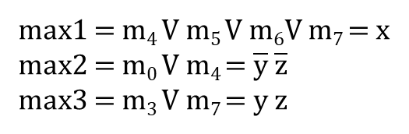
f₂(x, y, z) = x( y ­↑ z ) V $\overline{x}$( $\overline{y}$ ⊕ z ) V y( $\overline{x}$ ⊕ $\overline{z}$)
x | y | z | y ­↑ z | $\overline{y}$ ⊕ z | $\overline{x}$ ⊕ $\overline{z}$ | x( y ­↑ z ) | $\overline{x}$( $\overline{y}$ ⊕ z ) | y( $\overline{x}$ ⊕ $\overline{z}$) | f₂(x, y, z)
0 | 0 | 0 | 1 | 1 | 0 | 0 | 1 | 0 | 1
0 | 0 | 1 | 1 | 0 | 1 | 0 | 0 | 0 | 0
0 | 1 | 0 | 1 | 0 | 0 | 0 | 0 | 0 | 0
0 | 1 | 1 | 0 | 1 | 1 | 0 | 1 | 1 | 1
1 | 0 | 0 | 1 | 1 | 1 | 1 | 0 | 0 | 1
1 | 0 | 1 | 1 | 0 | 0 | 1 | 0 | 0 | 1
1 | 1 | 0 | 1 | 0 | 1 | 1 | 0 | 1 | 1
1 | 1 | 1 | 1 | 1 | 0 | 1 | 0 | 0 | 1
m₀
m₃
m₄
m₅
m₆
m₇
DCF(f)=m₀Vm₃Vm₄Vm₅Vm₆Vm₇=($\overline{x}$∧$\overline{y}\text{∧}\overline{z}) \text{∨} \text{(}\overline{x}\text{∧}\text{y}\text{∧}\text{z}) \text{∨}$($\text{x}$∧$\overline{y}\text{∧}\overline{z}) \text{∨}$($\text{x}$∧$\overline{y}\text{∧}\text{z}) \text{∨}$($\text{x}$∧$\text{y}\text{∧}\overline{z}) \text{∨}$($\text{x}$∧$\text{y}\text{∧}\text{z})$
Simplification with Karnaugh’s method:
yz
Factorization process:
x | 00 | 01 | 11 | 10
0 | m₀ |  | m₃
1 | m₄ | m₅ | m₇ | m₆
max1 = m₄ V m₅ V m₆V m₇ = x
max2 = m₀ V m₄ = $\overline{y}$ $\overline{z}$
max3 = m₃ V m₇ = $y$ $z$

Slide 7

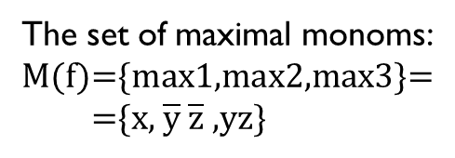

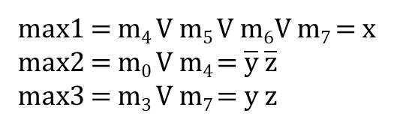


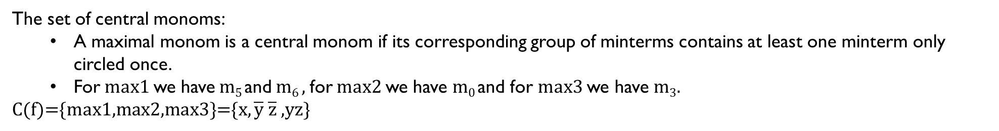

Factorization process:
max1 = m₄ V m₅ V m₆V m₇ = x
max2 = m₀ V m₄ = $\overline{y}$ $\overline{z}$
max3 = m₃ V m₇ = $y$ $z$
The set of maximal monoms:
M(f)={max1,max2,max3}=
={x, $\overline{y}$ $\overline{z}$ ,yz}
The set of central monoms:
A maximal monom is a central monom if its corresponding group of minterms contains at least one minterm only circled once.
For max1 we have m₅ and m₆ , for max2 we have m₀ and for max3 we have m₃.
C(f)={max1,max2,max3}={x, $\overline{y} \overline{z}$ ,yz}
Because M(f)=C(f) we will apply the first case of simplification algorithm:
There is a unique simplified form of f, obtained as the disjunction of all central monoms:
f ^{S}₂(x, y, z) = max1 V max2 V max3 = x V $\overline{y}$ $\overline{z}$ V yz
x
y
z
$$\overline{y}$$
$\overline{y}$ $\overline{z}$
AND
$$\overline{z}$$
y
x V $\overline{y}$ $\overline{z}$ V yz
yz
AND
OR
z
x

Slide 8
Thank you!

